Slide 1
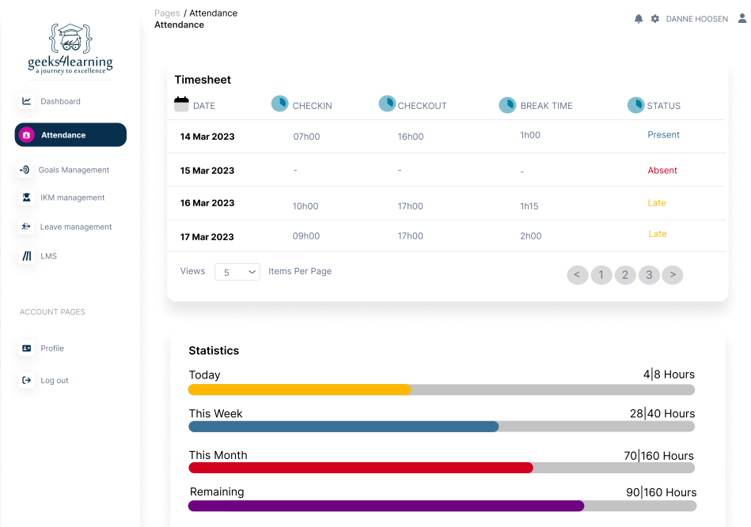

Attendance Management System
An Innovative Approach to Attendance Tracking

Slide 2
Problem Statement.
Attendance: Tracked through the use of ERS Biometrics System.
Technical Issues: Biometric systems may experience technical glitches, leading to inaccuracies in attendance records.
Tailgating Concerns: This poses a risk of stealing working hours and facilitating extended lunch breaks.

Slide 3

Our Team.

Slide 4
Our Solution.
Enhancing attendance tracking
Work closely with the existing ERS Biometrics System to provide a seamless attendance tracking process.
Ensures compliance with attendance policies.
Utilizing IP address, geolocation data, and device specifications to verify that the Geek has attended from the correct location and with the appropriate device.

Slide 5

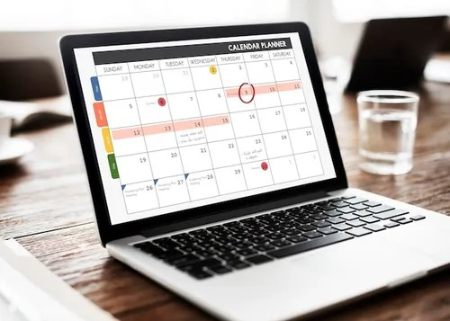
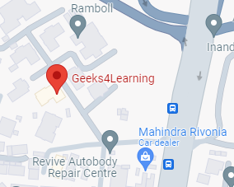

Our System.
Explore system key features.
Streamlines Attendance Tracking
Login Location Check
Automatic Leave Update

Slide 6




Technologies Used.
Tech Stack Overview
Frontend development
Database Management
Backend development
API Testing

Slide 7

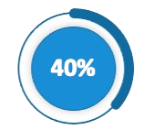
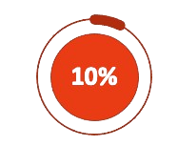
System Progress.
System Progress Overview.
System Documentation
Backend Development
Frontend Development

Slide 8
Conclusion
In conclusion, our system aims to simplify attendance tracking, reduce administrative overhead
and saving valuable time and also enhance the overall accuracy of attendance records.

Slide 9

Q & A
Questions and Answers Session: Your Participation is Welcome.

